Slide 1
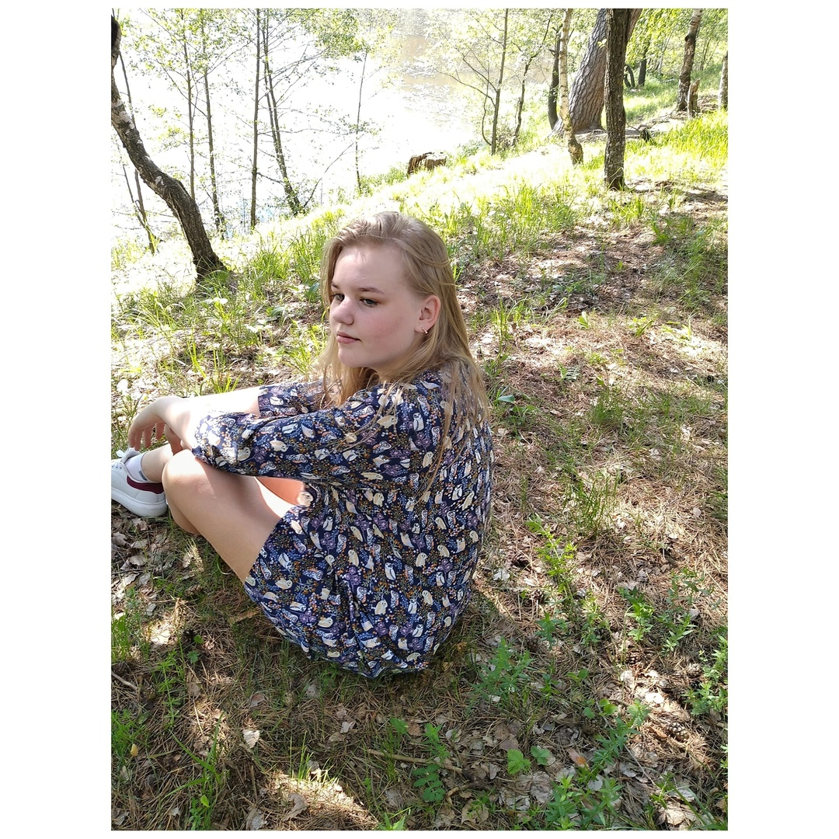
My name is Kristina Novikova. I'm 14 years old .

Slide 2
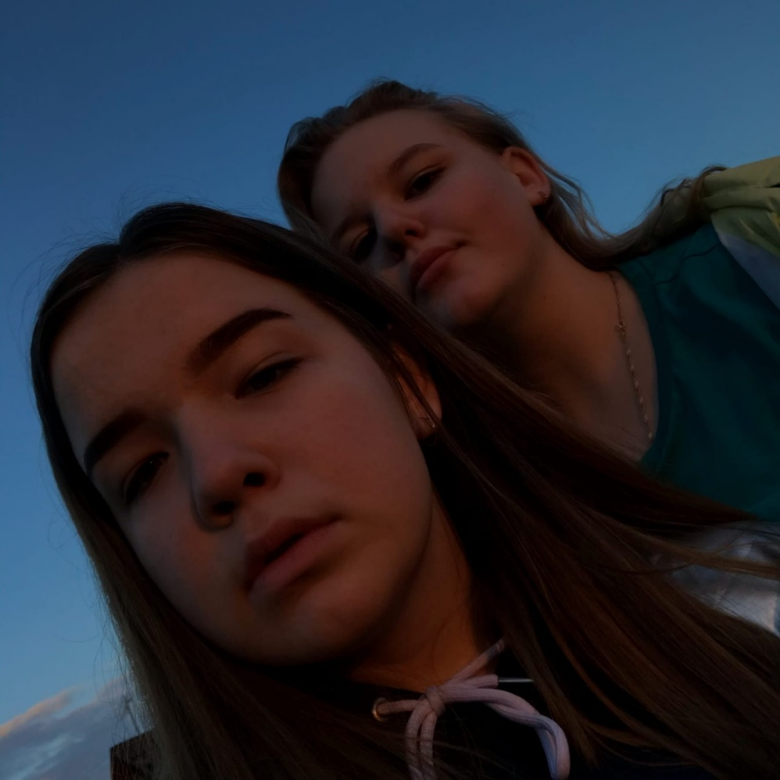
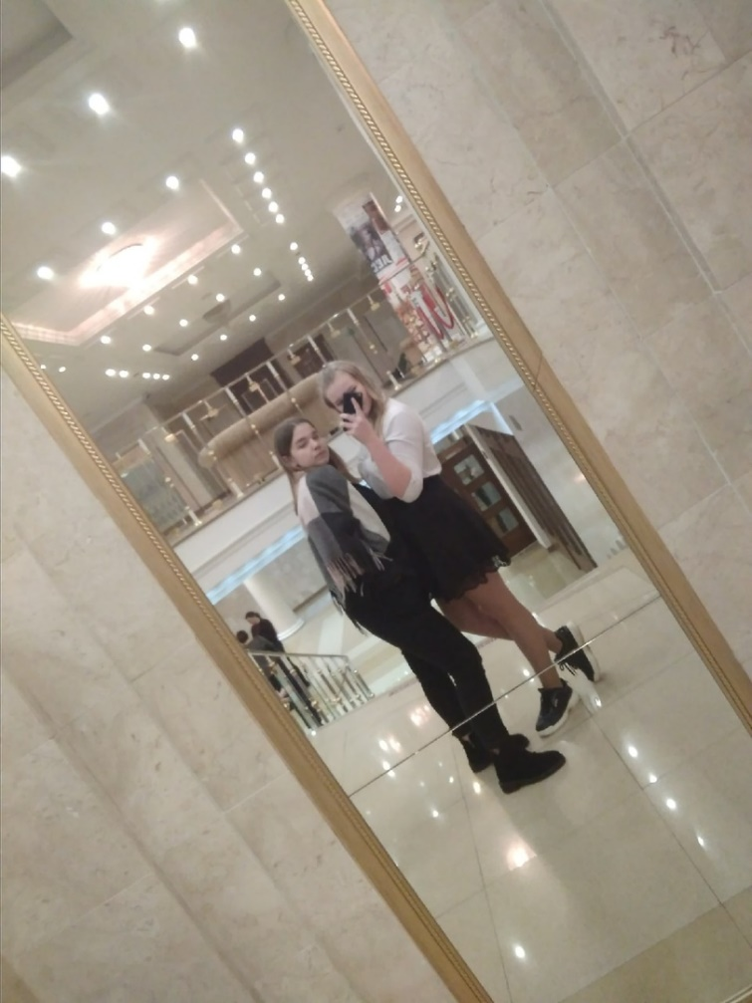
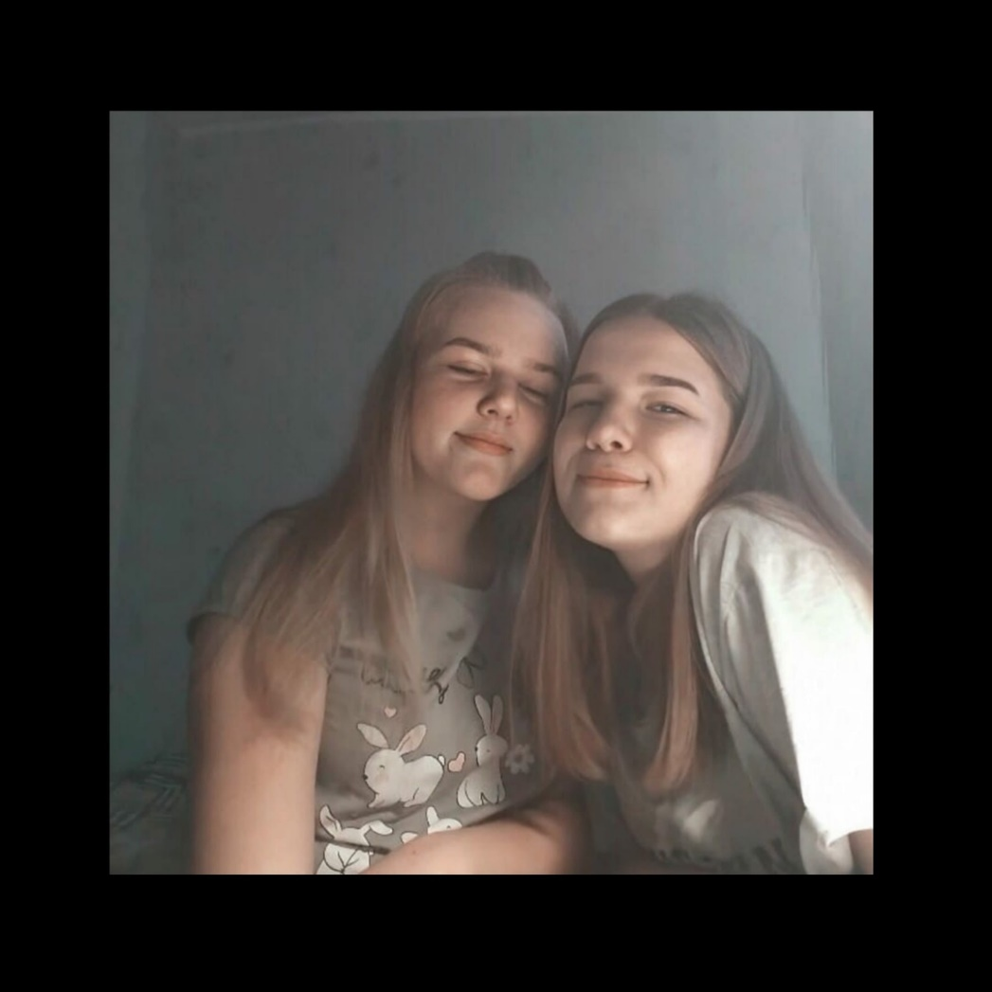
I usually spend my free time with my friends. I love and appreciate them very much.

Slide 3
I am attracted to a sport like volleyball.

Slide 4
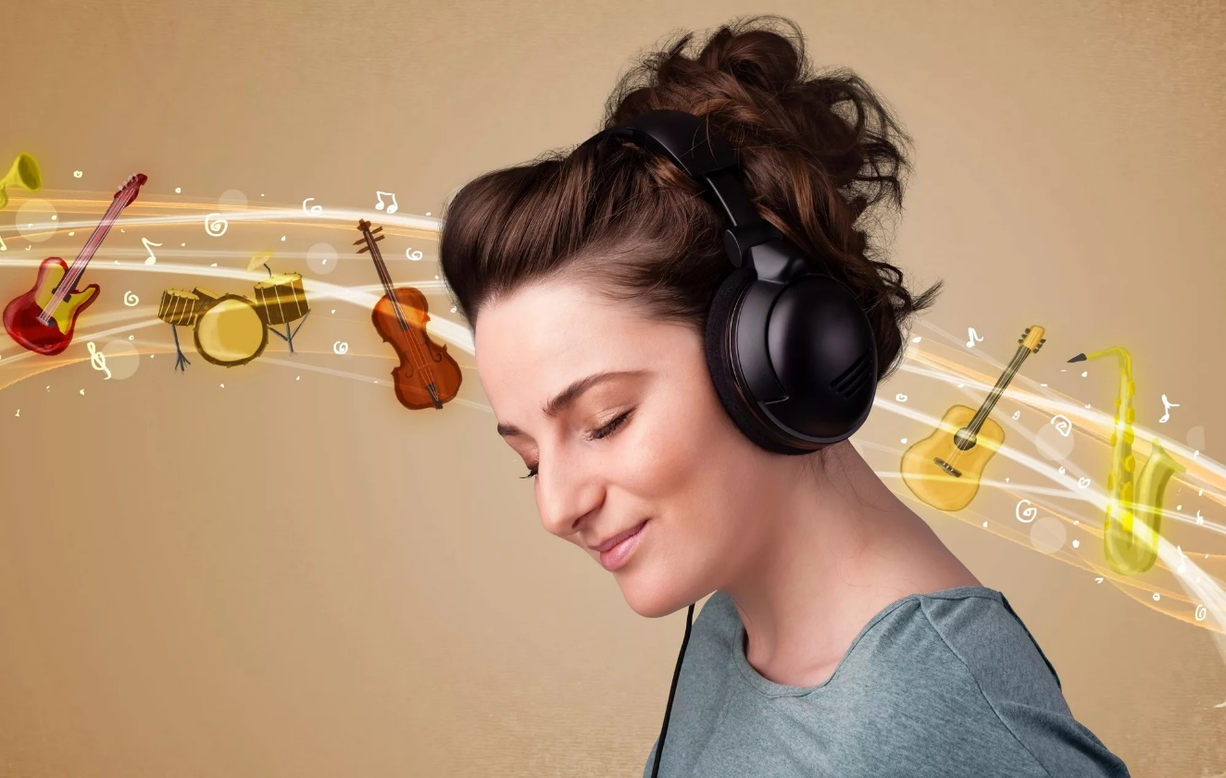
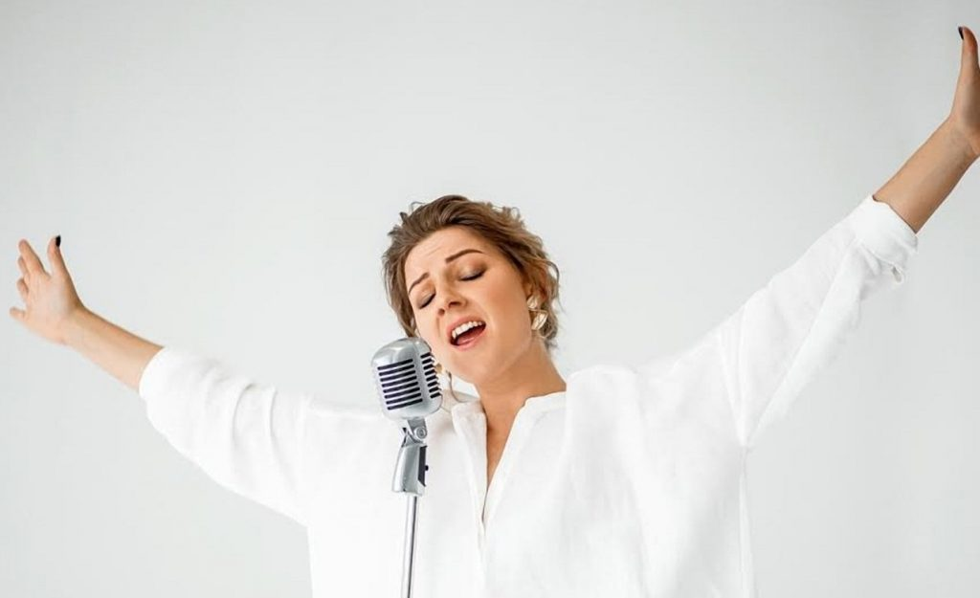
I love listening to music and I love singing even more. This is my main hobby!

Slide 5
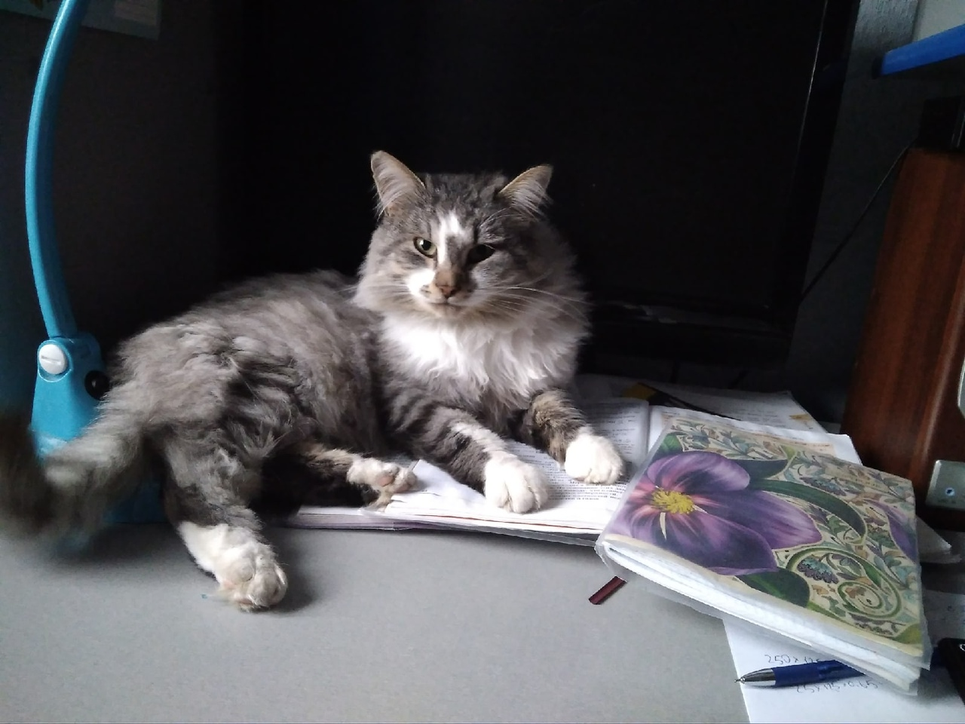
I LOVE MY PETS. IN PARTICULAR, I LIKE TO WALK WITH MY DOG. HIS NAME IS THUNDER. HE IS VERY FRISKY AND CHEERFUL.

Slide 6
I HAVEN'T DECIDED WHAT I WANT TO BE IN THE FUTURE. BUT I STILL HAVE A LOT OF TIME TO THINK AND MAKE A CHOICE!

Slide 7
THANK YOU FOR YOUR ATTENTION!

