Slide 1
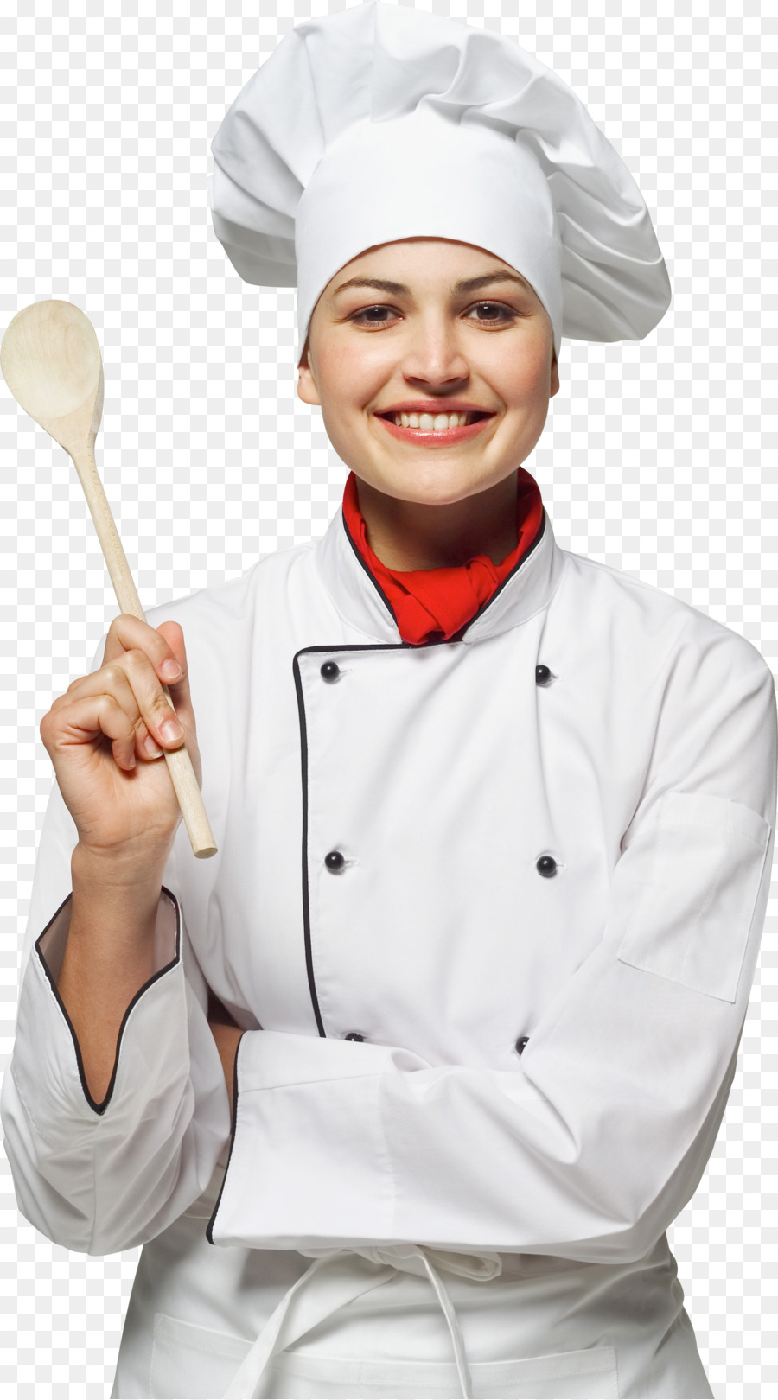

Slide 2
I still cant decide on a profession! I like to get involved in a lot of things, I have a desire to learn, I always try and learn.

Slide 3
In my free time, I read, do beads and knitting, I like all these interesting things.

Slide 4
I also just love to cook all sorts of yummy things, very often I cool at home and not a simple dinner, and I also all sorts of sweets.

Slide 5
And I wanted to become a pastry chef, but I was told that thi is not a profession and so Im still thinking about my future profession.

Slide 6
